Slide 1

ECE 2700
Digital Circuits
More RTL Design
Copyright © 2010 Frank Vahid
Instructors of courses requiring Vahid's Digital Design textbook (published by John Wiley and Sons) have permission to modify and use these slides for customary course-related activities, subject to keeping this copyright notice in place and unmodified. These slides may be posted as unanimated pdf versions on publicly-accessible course websites.. PowerPoint source (or pdf with animations) may not be posted to publicly-accessible websites, but may be posted for students on internal protected sites or distributed directly to students by other electronic means. Instructors may make printouts of the slides available to students for a reasonable photocopying charge, without incurring royalties. Any other use requires explicit permission. Instructors may obtain PowerPoint source or obtain special use permissions from Wiley – see http://www.ddvahid.com for information.

Slide 2
Today’s Objective
To become familiar with more advanced RTL design

Slide 3
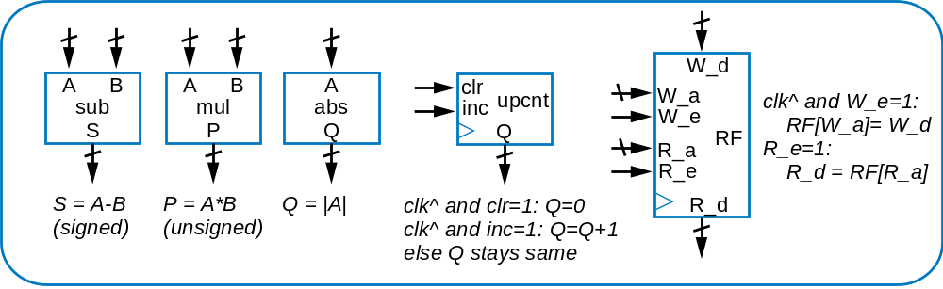
Datapath Component Library (Extended)
clr
I
A
B
A
B
I
I
1
I
0
ld
reg
add
cmp
shift<L/R>
mux2x1
Q
S
lt
eq
gt
Q
s0
Q
clk^ and clr=1: Q=0
S = A+B
(unsigned)
shiftL1: <<1
s0=0: Q=
I
0
clk^ and ld=1: Q=
I
A<B: lt=1
shiftL2: <<2
s0=1: Q=
I
1
else Q stays same
A=B: eq=1
shiftR1: >>1
A>B: gt=1
...

Slide 4
More Complex RTL Design Example
When you need to use an array in an HLSM
  Use register files
Inputs: X and Y (8 bits each)
Outputs: P (8 bits)
Local storage: A[3:0] (8 bits)
Preg (8 bits)
init1
preg := 0
A[0] := X + Y
init2
A[0] == 1
A[0] != 1
out1
out2
preg := A[1]
preg := 0

Slide 5
More Complex RTL Design Example
Inputs: X and Y (8 bits each)
Outputs: P (8 bits)
Local storage: A[3:0] (8 bits)
Preg (8 bits)
X
Y
+
init1
Amux+
preg := 0
A[0] := X + Y
1
A_Wa0
W_a
W_d
A_Wa1
A_We
W_e
A
A
B
A_Ra0
R_a
RF[4](8)
Acmp
A_Ra1
lt
eq
gt
init2
A_Re
R_e
R_d
A_eq_1
A[0] == 1
A[0] != 1
Preg_clr
clr
I
Preg_ld
ld
Preg
out1
out2
Q
preg := A[1]
preg := 0
DP
P

Slide 6

More Complex RTL Design Example
Inputs: X and Y (8 bits each)
Outputs: P (8 bits)
Local storage: A[4] (8 bits)
Preg (8 bits)
X
Y
Preg_clr = 1
A_Wa1 = 0
A_Wa0 = 0
A_We = 1
+
init1
Amux+
preg := 0
A[0] := X + Y
A_Wa0
W_d
1
A_Wa1
W_a
A_Ra1 = 0
A_Ra0 = 0
A_Re = 1
A_We
W_e
A
A
B
A_Ra0
R_a
RF[4](8)
Acmp
A_Ra1
lt
eq
gt
init2
A_Re
R_e
R_d
A_eq_1
A_eq_1’
A_eq_1
A[0] == 1
A[0] != 1
Preg_clr
clr
I
Preg_ld
ld
Preg
out1
out2
Q
What if the register file is outside of this datapath?
preg := A[1]
A_Ra1 = 0
A_Ra0 = 1
A_Re = 1
Preg_ld = 1
preg := 0
DP
P

Slide 7
HLSM & Loop
Design a system that computes and outputs the sum of all numbers inside a 64x32 register file A
  sum = 0;
  for (int i=0; i<64; i++)
    sum := sum + A[i];
S1
sum := 0
i := 0
S2
i<64
(i<64)’
sum:=sum+A[i]
Why is this OK?
S3
i := i + 1
S4
(done)

Slide 8
Now You Try
Design a system that computes and outputs the sum of all positive numbers inside a 512x32 register file A
S1
sum := 0
i := 0
S2
i<64
(i<64)’
S3
sum:=sum+A[i]
i := i + 1
S4
(done)

Slide 9
Solution
Design a system that computes and outputs the sum of all positive numbers inside a 512x32 register file A
S1
sum := 0
i := 0
S2
i<512
S3
(A[i] < 0)’
sum:=sum+A[i]
S4
A[i] < 0
(i<512)’
i := i + 1
S5
S6
(done)

Slide 10
Today’s Objective
To become familiar with more advanced RTL design

Slide 11
Question
We want to construct an HLSM that turns on the laser beam for Y seconds once B is pressed. What should be in the blank rectangle?
Inputs: B; Outputs: X;
Register: Cnt (2 bits)
X=0
Cnt=Y
Off
B'
Cnt=0
B
X=1
On
(Cnt=0)'

